Slide 1
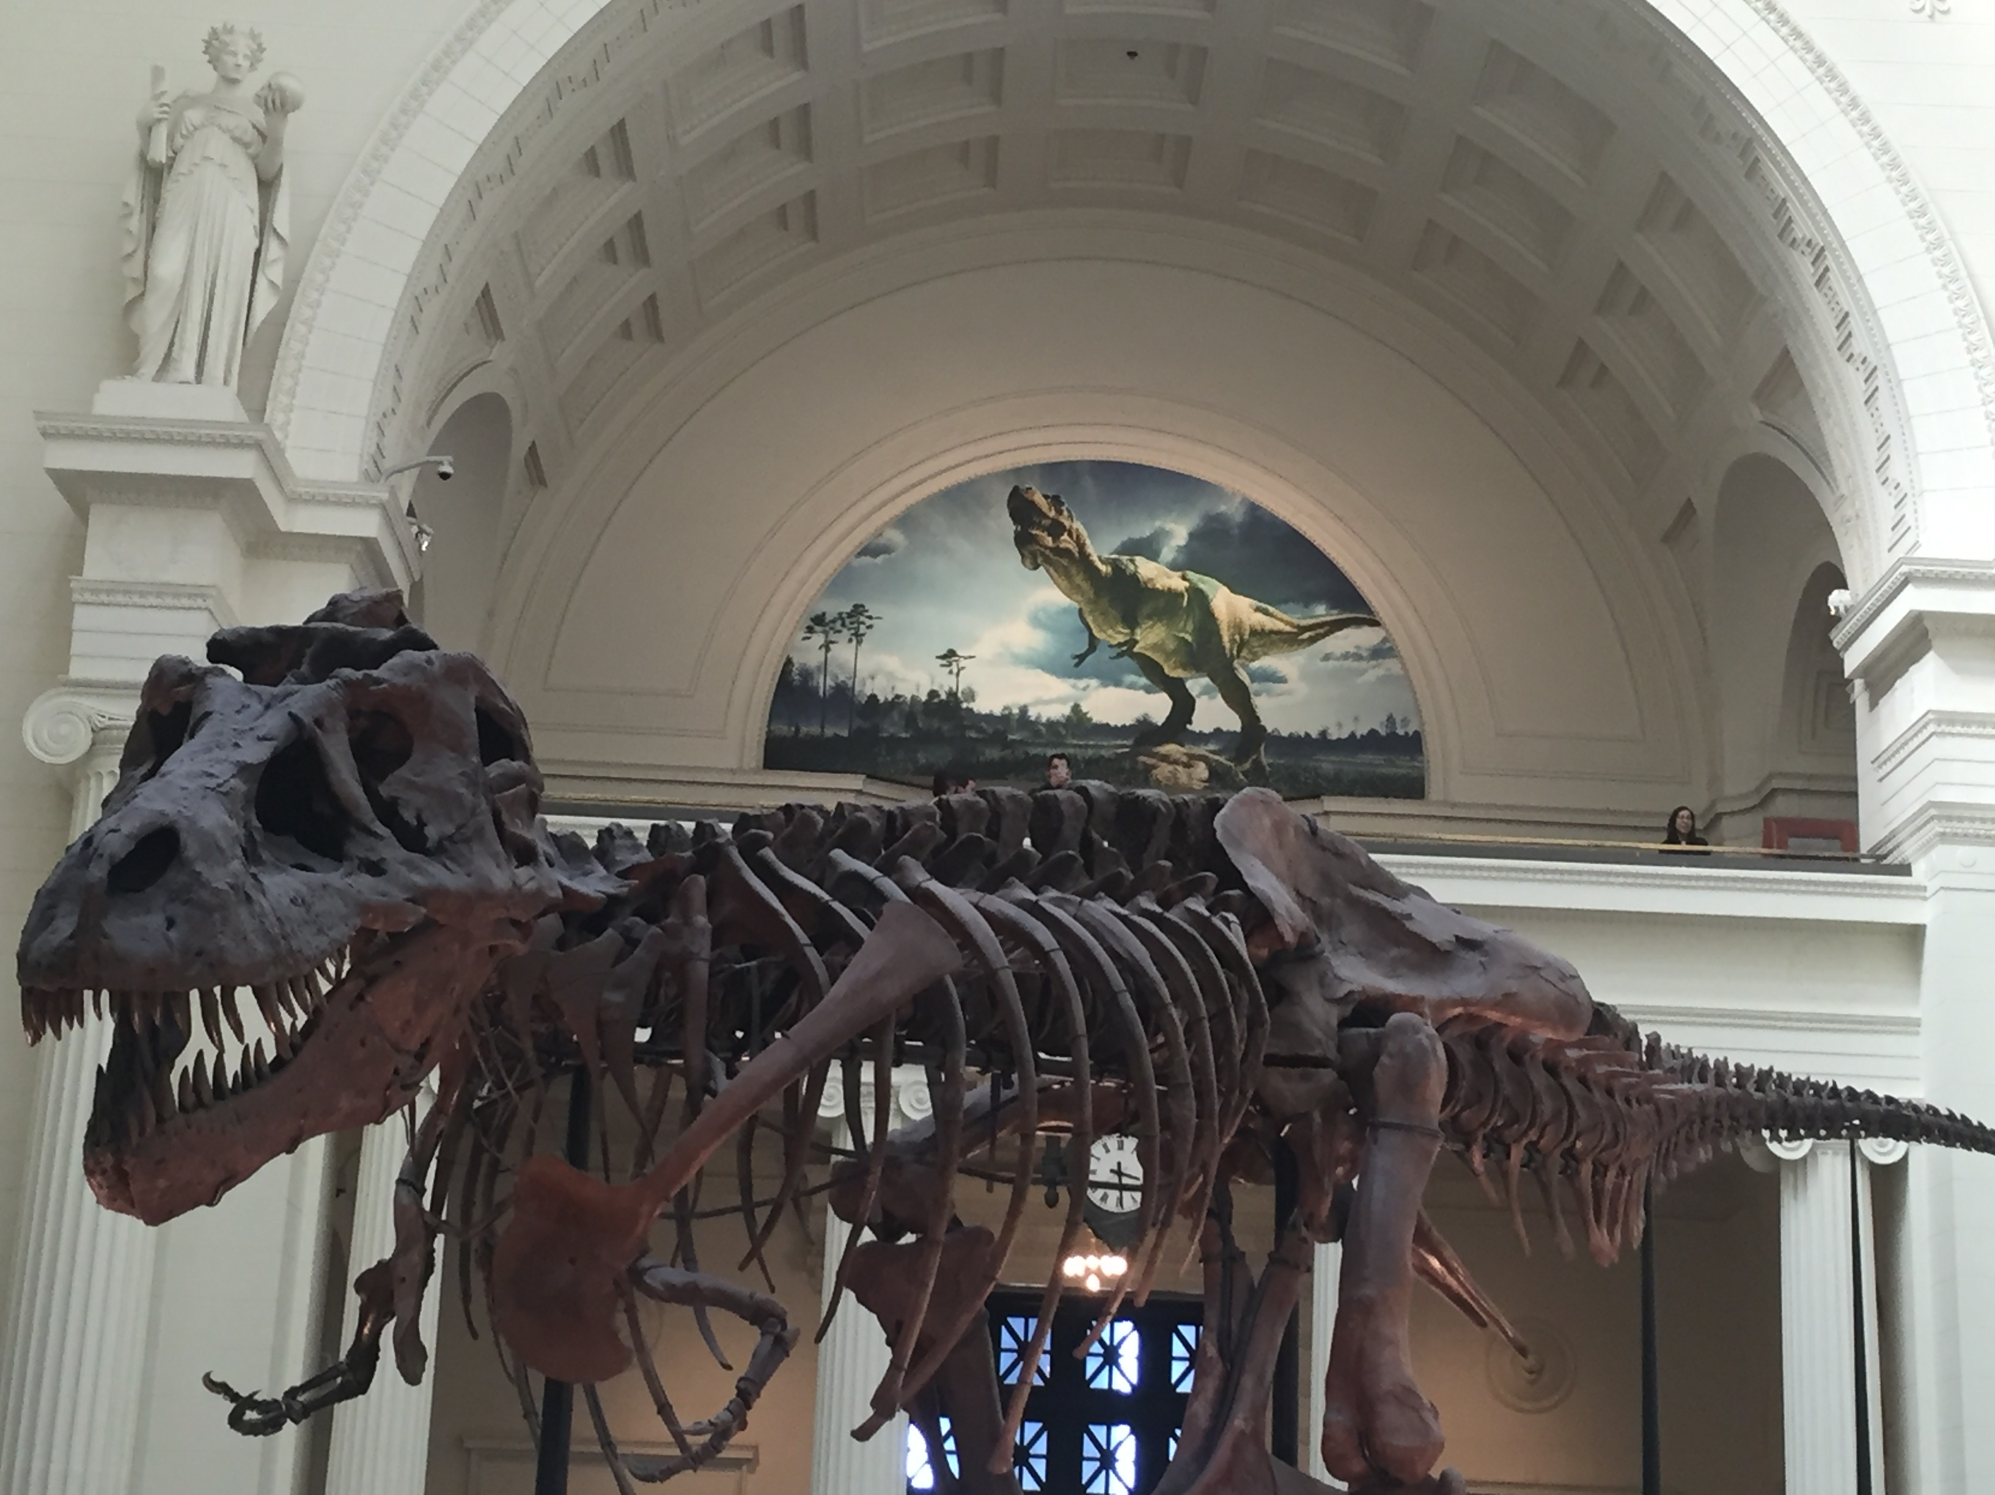
Fun With
Dinosaurs

